Slide 1



“ BLOGGING WEBSITE”
Task - 2

Slide 2


SUNSTONE
Project Name : “ BLOGGING WEBSITE ”
An blogging website is basically a informative website it holds many important and informative contents. And the user can easily handle the website they can post , comment, read and like the content they like.
S.NO | LMS Username | Name | Batch
1 | @yuvarajooo1 | Yuvaraj.S | 1
2 | @Pavi06thra | Pavithra.M | 1
3 | @mageshwariperumal | Mageshwari.P | 1
4 | @Jeevi58 | Jeevitha.G | 1

Slide 3
SUNSTONE
STEP WISE DESCRIPTION
Define Your Niche and Purpose
Choose a Theme
Create Essential Pages
Configure SEO Settings
Design and Customize
Regularly Update and Maintain
Install Essential Plugins
Set Up a Content Management System (CMS)
Design and Customize:

Slide 4
SUMMARY
The purpose of a blogging website is to provide a platform for individuals or organizations to share information, insights, and experiences on a specific topic or range of topics. It serves as a medium for communication, education, and entertainment, allowing authors to connect with an audience, express their ideas, and potentially generate revenue through various monetization strategies. Additionally, a blogging website can establish authority in a niche, foster a sense of community, and contribute to personal or brand development.

Slide 5
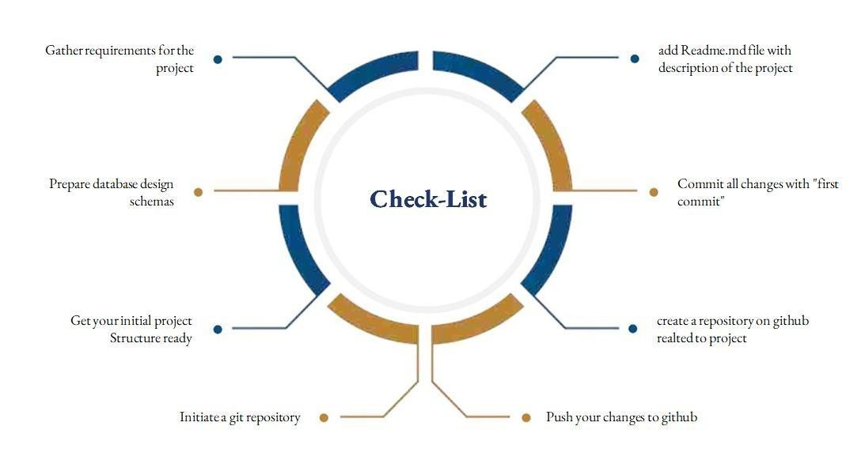
SUNSTONE
Assesment Parameter

Slide 6
Submission Github
SUNSTONE
https://github.com/yuvarajooo1/NM-AIT-GROUP1

Slide 7


SUNSTONE

